Slide 1


ASTOR AI
MEDICAL CHAT DOCTOR
A Presentation by
SRIKAR VELUVALI (G33)

Slide 2


Introduction
Astor AI (ASk docTOR) is a cutting-edge chatbot designed to provide medical assistance to patients, especially in scenarios where doctors may not be readily available. Utilizing the advanced Llama3 model fine-tuned with a custom dataset, Astor AI aims to address patient queries and offer preliminary medical advice.
Problem Statement
In many situations, accessing immediate medical advice can be challenging, particularly for non-critical conditions. There is a significant potential for AI to bridge this gap by providing reliable and timely responses to patient queries, enhancing the accessibility of healthcare information.
Develop a robust AI-powered chatbot capable of understanding and responding to medical queries.
Ensure the chatbot provides relevant and accurate answers, improving the quality of initial diagnosis and guidance.
Implement features that mimic doctor appointments, allowing users to have detailed and contextually relevant interactions.

Slide 3


Tech Stack
Artificial Intelligence And Machine Learning
Llama 3 Model
Huggingface
Ollama
Google Colab
Database
MongoDB
Frontend
ReactJS
Backend
Python
Flask
Authorization and Authentication
JWT

Slide 4
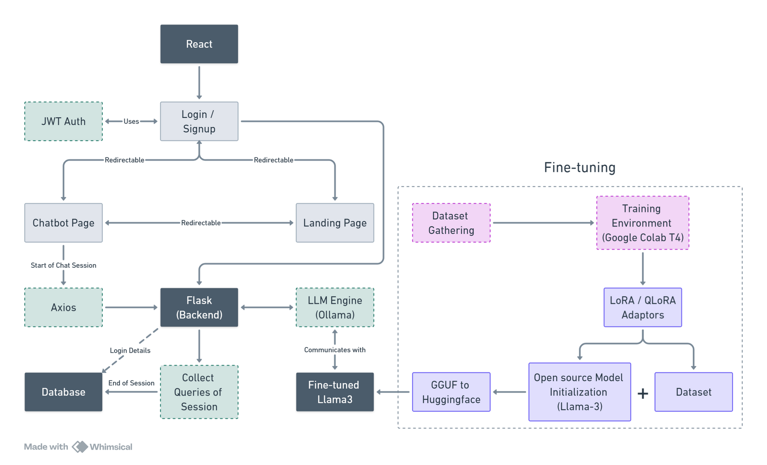

Architecture

Slide 5
Demonstration

Slide 6
Thank
You

